Slide 1
Sign Language Recognition
Presented by..
Vatsal Patel,
Prem Surani,
Manan Poojara

Slide 2
Agenda
What is AI ?
What is Machine Learning?
What is the difference between Computer vision and machine learning ?

Slide 3
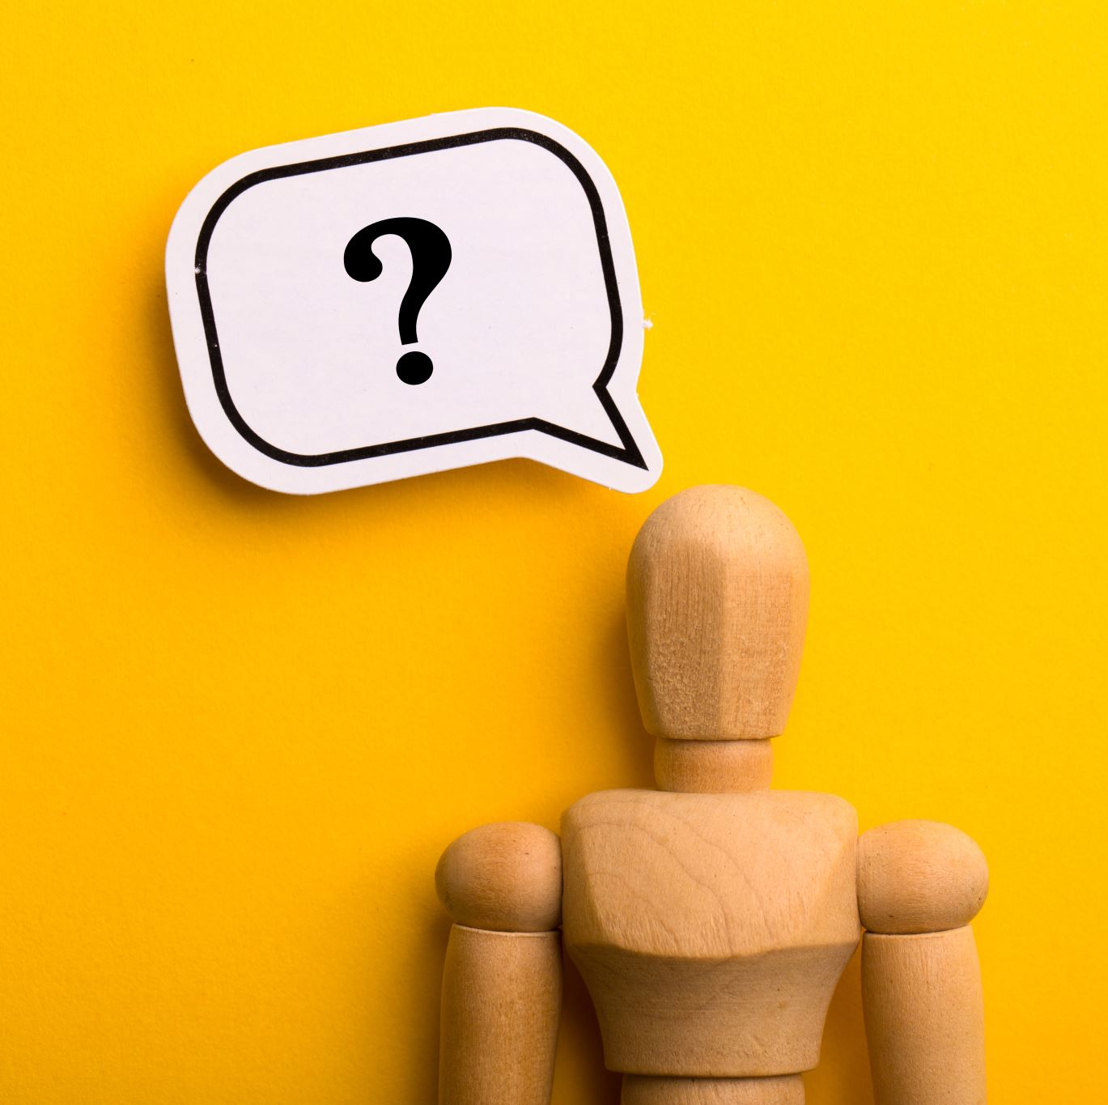
What is Ai ?
Smart machines that capable of performing tasks that require human intelligence.
“The science and engineering of making intelligent machines”. - john McCarthy
AI
ANI
(Artificial Narrow Intelligence)
AGI
(Artificial General Intelligence)

Slide 4
ANI (Artificial Narrow Intelligence)
Almost all the progress we are seeing in the ai today is ANI.
Ex. Smart speaker, self driving car etc..
AGI (Artificial General Intelligence)
Do anything a human can do.

Slide 5

What is Machine Learning?
Field of study that gives computers the ability to learn without being explicitly programmed.
The most common type of machine learning is supervised learning that learns A to B or input output mapping.
A B
Input Output
Let’s see some examples..

Slide 6
Supervised Learning
Input(A) | Output(B) | Applications
email | Spam? | Spam filtering
Audio | Text transcript | Speech recognition
English | Gujarati | Machine translation
Video | Text, speech | Object detection

Slide 7
What is the difference between computer vision and machine learning ?
What is Computer Vision ?
computer vision is ai technology that trains computers to derive meaningful information from images, video or other digital inputs.

Slide 8
Computer vision | Machine Learning
It helps system understand and interpret the visual world in the way human do. | It provides machines the ability to automatically learn and improve from their past experiences.
Focuses on developing techniques to make computers process, analysis and understand images, video or other digital inputs. | Focuses on building machines that can automatically learn from their experience without being explicitly programmed.
Applications include image recognition, driverless car testing, movement analysis etc.. | Application include speech recognition, traffic prediction, product recommendations, virtual assistant, email filtering etc..

Slide 9
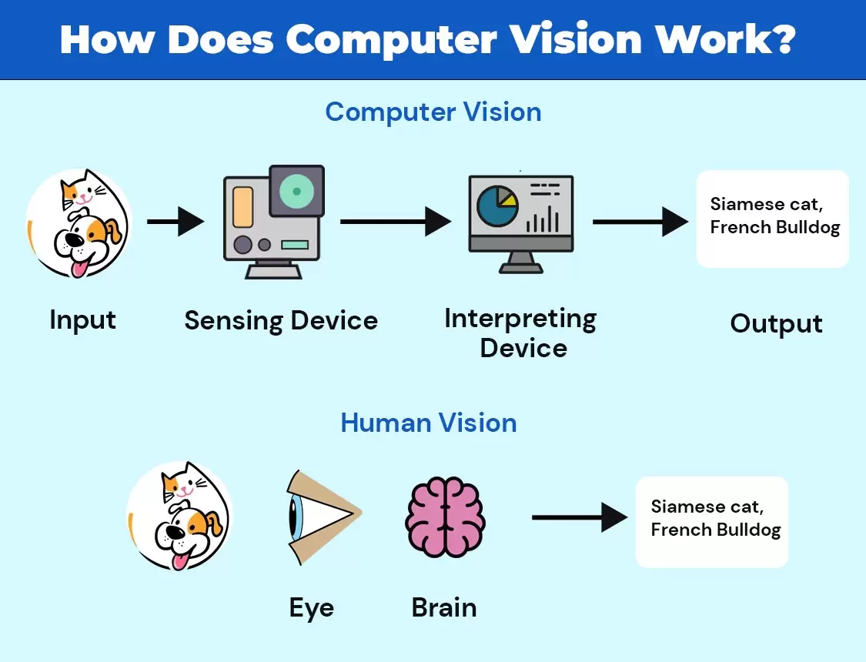
Human vision and computer vision

Slide 10

Sign language Recognition

Slide 11
Abstract
This website recognize Sign Language that helps normal users who can’t understand the language of D&M people.
This website converts sign language into understandable language which is easy to understand to the normal people.

Slide 12
Introduction
We make this website by using the concept of computer vision. We recognize the motion of hand of the user and analysis them, and then convert into text or speech.
We use Html, Css, Javascript to design the Front-End of the website.
We use python programming language as main language and Backend language.
Python libraries used for image processing or capturing ..
OpenCV
Tenserflow
Numpy
sklearn

Slide 13
Literature Review /Study
We find many website related to out project.
one of them is signall.com this website is mainly teaches the sign language, it also has app call Ace ASL that teaches the sign language with fun games.
We also found GnoSys app for mobile that converts sign language into text and speech in realtime.

Slide 14
Platform
We build a website that is portable in any device like laptop, mobile and tablet.

Slide 15
Scope
We are planning to enhance our website that work even when there is low image resolution or quality.
We also think to predict the sign motion in low light condition.
We are planning to secure our website that is protected from SQL injection or any other attacks.

Slide 16
Objectives
To get exact idea what D&M people want to say that normal user cannot understand.

Slide 17
Motivation
Enhance the communication between normal user and people who can’t speak.
If there is a common interface that converts the sign language to text the gestures can be easily understood by the other people.
The aim is to develop a user-friendly human computer interfaces (HCI) where the computer understands the human sign language.

Slide 18
Challenges
Effective GUI
Smooth motion detection
Get expected result
Maintenance
Feeding the correct data to model

Slide 19
Features
Detect motion of user hands
Process the motion
Translate sign language into text or audio
Registration
Features

Slide 20
Modules
Admin Module
Signup Module
Login Module
Home Module
Help Module
User Management Module
Users of the project
Admin
Registered user
Visitor or end user

Slide 21
Problem Statement
Dumb people use sign language to communicate so any normal user cannot understand the meaning of sign language.
Hance there is a need of system that convert the sign language into understandable language.

Slide 22
we know the concept of computer vision now we use this concept to build our project “sign language recognition”.
How it’s work ?
First, we capture the hand motion of the user using camera.
Then our system can take the image, analysis it and then predict the output as speech or text.
In this case the input is captured sign image and out is text or speech.
Understand by example..

Slide 23

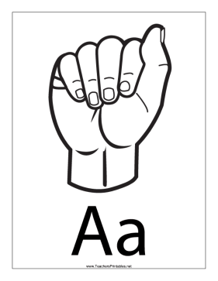


Web camera
Sign language image
Audio or text
Sign language translation application
Normal User

Slide 24
Summary
We learn about what is ai, machine learning and difference between machine learning and computer vision.
We discussed problem statement, introduction, abstract, scope, goal, objectives, Modules and user of the project.
By the end, we described working of the project with diagram.

Slide 25
Thank you
Vatsal Patel
Email address: vatsalp7057@gmail.com

